Slide 1
The School Outcomes Measure (SOM)™ Overview
University of Oklahoma Health Sciences Center College of Allied Health, Department of Rehabilitation Sciences
Sandra H. Arnold, PT, PhD
University of Oklahoma Health Sciences Center
Department of Rehabilitation Sciences
sandra-arnold@ouhsc.edu
Notes:
This ppt. begins the reliability training for the School Outcomes Measure, or the SOM. I am Sandra Arnold, from the University of Oklahoma Health Sciences Center, and Primary developer of the SOM. In this ppt I will give you an overview of the SOM and its items before we complete the reliability training with three student cases.

Slide 2
Objectives
At the conclusion of this presentation, participants will:
Understand the purpose, design, development, use, and content of the School Outcomes Measure (SOM)
Recognize the domains and items of the SOM
Access the SOM Research Page
Be prepared to complete reliability testing
University of Oklahoma Health Sciences Center College of Allied Health, Department of Rehabilitation Sciences
Notes:
At the conclusion of this presentation, you should:
Understand the purpose, design, development, use, and content of the School Outcomes Measure (SOM)
Recognize the domains and items of the SOM
Access the SOM Research Page and
Be prepared to complete reliability testing

Slide 3
Purpose
The SOM is a minimal data set for program evaluation of occupational therapy and physical therapy services provided in school settings (McEwen, Arnold, Hansen, & Johnson, 2003)
A minimal data set gathers information about a large number of students on an on-going basis, with the fewest number of items needed
Comprehensive, responsive, timely (Dobrzykowski, 1998)
The SOM takes about 10 minutes to administer when a therapist is familiar with the student
No manipulatives and no supplies, just test form
Criterion-referenced, judgement/observational based
Currently, no tool exists that measures the outcomes of students ages 3-21 years who receive school-based occupational therapy and physical therapy
University of Oklahoma Health Sciences Center College of Allied Health, Department of Rehabilitation Sciences
Notes:
We developed the SOM , a minimal data set for program evaluation of occupational therapy and physical therapy services provided in school settings, to gather information about a large number of students on an on-going basis, with the fewest number of items needed. We wanted it to be comprehensive, responsive, and timely .
Thus, the SOM takes about 10 minutes to administer when a therapist is familiar with the student, and requires no manipulatives or supplies, just a test form.
The SOM is criterion-referenced, judgement/observational based., therefor direct handling of the child is not necessary.
Currently, no tool exists that measures the outcomes of students ages 3-21 years who receive school-based occupational therapy and physical therapy

Slide 4
Therapists traditionally have measured outcomes of individual students
aggregation of data across students is important for program evaluation purposes and to understand the characteristics of particular groups of students (Dobrzykowski, 1998)
Program evaluation allows identification and comparison of overall student outcomes at local, state, or national levels, and also can identify variables with which various outcomes are associated
service delivery models
types of interventions
child characteristics
service intensity and frequency (Goossen et al., 1998)
University of Oklahoma Health Sciences Center College of Allied Health, Department of Rehabilitation Sciences
Notes:
Therapists traditionally have measured outcomes of individual students but aggregation of data across students is important for program evaluation purposes and to understand the characteristics of particular groups of students
Program evaluation allows identification and comparison of overall student outcomes at local, state, or national levels, and also can identify variables with which various outcomes are associated such as service delivery models, types of interventions, child characteristics, and service intensity and frequency

Slide 5
SOM Design
Construct of Interest
Outcomes of students who receive school-based occupational therapy and physical therapy
Schools have been the first or second most popular employment setting for occupational therapists and are the primary work setting for the APTA Academy of Pediatric Physical Therapy members (AOTA, 2000, 2015; APTA, 2002)
OT/PT services mandated by IDEA (34 CFR, 2006)
Therapists are responsible for evaluating the effectiveness of their interventions and the outcomes of the students they serve
University of Oklahoma Health Sciences Center College of Allied Health, Department of Rehabilitation Sciences
Notes:
Because schools are prevalent employment settings for both OTs and PTS, and because OT and PT services are mandated by IDEA , and because therapists are responsible for evaluating the effectiveness of their interventions and the outcomes of the students they serve, we designed the SOM based on the construct of Outcomes of students who receive school-based occupational therapy and physical therapy.

Slide 6
Conceptual framework
The SOM theoretical framework is based on the International Classification of Functioning Disability and Health (ICF), with participation being the construct of measurement
Participation is defined as the nature and extent of involvement at various levels of participation: engagement, involvement, and motivation
Nature of participation in the school setting requires acquiring knowledge, expressing learning, assuming a student’s role, and performing self care, and mobility (SOM domains) (Bundy, 1991)
The extent of student participation is measured through Ability (items students can do), capability (items students have the potential to do), engagement (students actual participation in any activity/item to learn), and severity (extent of student limitation classified by the Gross Motor Classification System – GMFCS, and the Manual Ability Classification System-MACs)
University of Oklahoma Health Sciences Center College of Allied Health, Department of Rehabilitation Sciences
Notes:
The SOM theoretical framework is based on the International Classification of Functioning Disability and Health (ICF), with participation being the construct of measurement . Participation is defined as the nature and extent of involvement at various levels of participation including engagement, involvement, and motivation
Nature of participation in the school setting requires acquiring knowledge, expressing learning, assuming a student’s role, and performing self care, and mobility. The SOM domains include the latter five.
The extent of student participation is measured through Ability (items students can do), capability (items students have the potential to do), engagement (students actual participation in any activity/item to learn), and is measured through our Likert rating scale , with severity , the extent of student limitation , classified on the SOM by the Gross Motor Classification System – GMFCS, and the Manual Ability Classification System-MACs

Slide 7
SOM Development: Methodological Research/ Psychometric Properties
McEwen, I.R., Arnold, S.H., Hansen, L.H., & Johnson, D. Interrater reliability and content validity of a minimal data set to measure outcomes of students receiving school-based occupational therapy and physical therapy. Physical & Occupational Therapy in Pediatric. 2003;23(2): 77-95.
Arnold, S. H. & McEwen, I.R. Item test-retest reliability and responsiveness of the School Outcomes Measure (SOM). Physical & Occupational Therapy in Pediatrics.2008;28(1): 59-77.
Arnold, S. H., Kolobe, T.H.A., Thompson, D.M., Boeckman, L. (2013). Assessing the Discriminative Ability and Internal Consistency of the School Outcomes Measure ISRN Rehabilitation. 2013; 2013, Article ID 607416, 8, Pages, http://dx.doi.org/10.1155/2013/607416
University of Oklahoma Health Sciences Center College of Allied Health, Department of Rehabilitation Sciences
Notes:
As mentioned in the OHSC Research Study Introduction ppt, we have conducted methodologic research of the SOM.
This slide, #7, and the following slide, #8, show our initial research and results. The next two slides, slide #9, and slide #10, demonstrate our most recent research and results. Please take the time to review these slides to appraise the SOM’s current psychometric properties. Click the <enter> or forward arrow keys to advance through these 4 slides. The audio will continue on slide # 11.

Slide 8
SOM Properties at that time…
Established content validity, interrater reliability and stability
Able to show change over time in students with mild/moderate functional limitations in all student ability areas
Less sensitive to change over time for students with severe functional limitations
The correlations between many of the items and the five ability areas were high, showing consistency of the items within each area of the SOM are related
University of Oklahoma Health Sciences Center College of Allied Health, Department of Rehabilitation Sciences
Notes:
[No audio]

Slide 9
Methodological Testing, cont.
Wilson, R.A..A.., Kolobe, T.H.A., Arnold, S. H., & McEwen, I.R (2015). Concurrent Validity of the School Outcomes Measure (SOM) and Pediatric Evaluation of Disability Inventory (PEDI) in Preschool Aged Children. Physical & Occupational Therapy in Pediatrics, 35(1), 40-53.
Measuring the Outcomes of Students: Rasch Analysis of the School Outcomes Measure
Arnold, SH., Kolobe, TKA, Smith, E. 2014 – manuscript in draft
Rasch Analysis of SOM with Secondary Students
MacRone-Wojton, M., Arnold, SH, Kolobe, TKA, DeGrace, B (2015) – manuscript in draft
Concurrent Validity of the School Outcomes Measure (SOM) and the School Function Assessment (SFA)
Klug, K, Arnold, S.H., Kolobe, T.H.A., Silverman, M. (2016) – manuscript in review
University of Oklahoma Health Sciences Center College of Allied Health, Department of Rehabilitation Sciences
Notes:
[No audio]

Slide 10
SOM Properties at this time…
Concurrent with the PEDI (best with mobility) and the SFA (best with Self-care, Mobility, and Assuming Student’s Role)
Reduction of items
SOM is multidimensional
2-3 potential functional subscales
Mobility, Manipulation in Learning, & Behavior
Subscales can be used and added separately, rather than a total scale
Little redundancy and wide range of items that discriminate between students
May need to add easier mobility items (for Level V) and harder manipulation items (for Level I)
University of Oklahoma Health Sciences Center College of Allied Health, Department of Rehabilitation Sciences
Notes:
[No audio]

Slide 11
Clinical Use and Applications
The SOM is a practical tool for school-based occupational therapists and physical therapists to use to collect population outcomes of students with disabilities who receive their services
Continued psychometric testing and revision of the tool is indicated prior to its open access national data collection
University of Oklahoma Health Sciences Center College of Allied Health, Department of Rehabilitation Sciences
Notes:
Through our research we have found that the SOM is a practical tool for school-based OTs and PTs to use to collect population outcomes of students with disabilities who receive their services
However, continued psychometric testing and revision of the tool is indicated prior to its open access national data collection

Slide 12
Current Study
Combine all recent research data and used the Rasch Item analysis to develop an updated SOM scale to be used with a nationwide sample of 1200 children that are stratified based on age and level of disability severity at baseline (start of school year)
Re-administer the SOM at 4.5 and 10 months following baseline, and also administer the PEDI-CAT. Together with anchoring Rasch techniques, determine the SOM change scores that represent a MSFD
Use the REDCap to develop an open access SOM data collection system that can be used by any therapist nationwide.
University of Oklahoma Health Sciences Center College of Allied Health, Department of Rehabilitation Sciences
Notes:
In our current IES study, we have combined all recent research data from elementary and high school age cohorts and used the Rasch Model analysis to examine item hierarchy and dimensionality. We updated the SOM based on the Rasch analysis and will use this tool with a nationwide sample of 1200 children that are stratified based on age and level of disability severity
Therapists will administer the SOM at the start of the school year, and again at 4.5 months and at 10 months following baseline. Therapists will also administer the PEDI-CAT at these same time frames. Together with anchoring Rasch techniques, we will determine the SOM change scores that represent a MSFD
We will then use the technological experience gained from REDCap to develop an open access SOM data collection system that can be used by any therapist nationwide.

Slide 13
SOM Content
Demographics
Student Information (Age, DOB, grade level, sex, ethnicity, Primary Dx, GMFCS and MACs levels, educational setting, AT and equipment use)
Student’s IEP Information (IDEA disability category, educational placement, frequency and duration of therapy visit
Related Services Information (most frequent service provider and environment for intervention, contact with teacher and parent/caregiver, outside of school OT and PT services, and number of visits per year)
Therapist Information (ID, profession, years of experience, years worked with student)
University of Oklahoma Health Sciences Center College of Allied Health, Department of Rehabilitation Sciences
Notes:
As a minimal data set and to gather program outcomes, the SOM collects demographic information about the student, such as age, grade level and severity level; the student’s IEP information, such as the student’s IDEA disability category and their frequency and duration of therapy; related services information, such as most frequent service provider and number of visits per year; and therapist information, such as years of experience and years worked with this student.

Slide 14
Therapy Activities & Student Abilities
Therapy Activities (ADLs, AT, mobility, school-related activities, performance components, other interventions) and percentage of time spent on each
Five student functional ability areas (41 items)
Self-Care (5 items)
Mobility (9 items)
Assuming a Student’s Role (17 items)
For Preschool/Elementary
For Secondary School (Mid/Junior and High)
Expressing Learning (6 items)
For students unable to use speech
For all students
Behavior (4 items)
6-point Likert response scale
Total Assistance = 1 to Independent = 6
University of Oklahoma Health Sciences Center College of Allied Health, Department of Rehabilitation Sciences
Notes:
The SOM also includes a section for therapists to include therapy activities used with the student, and the percentage of time spent on each therapy activity. These activities include Activities of Daily Living, Assistive Technology, mobility, school related activities, performance components, and other interventions.
The five functional ability areas (or domains) captured in the SOM are Self care, with 5 items, Mobility with 9 items, Assuming a Student’s Role for both preschool and elementary aged students and for secondary aged students in middle/junior or high school, and includes 17 items, Expressing Learning, that includes a total of 6 items for all students and for students unable to use speech, and Behavior, with 4 items. The items are scored within the context of the school setting and/or maybe included on the students IEP for related services.
Therapists score the SOM using a 6-point Likert student ability scale from 1, Total Assistance to 6, Independent

Slide 15
Student Abilities: SOM Response Scale
Indicate the level of assistance the student requires to perform the entire activity. The student may use adapted equipment or environment modification at any level of the scale.
Total Assistance: Student cannot perform the activity and does not provide any meaningful assistance
Maximum Assistance: Adult assumes most of the responsibility for the activity and/or has hands on the student or materials for more than 1/2 of the activity
Moderate Assistance: An adult helps the student with the activity, with hands on the student or materials for less than or equal to 1/2 of the duration of the activity, but more than momentarily
Minimal Assistance: The student does the activity with only momentary hands on support by an adult
Supervision: An adult monitors the student's activities with verbal and/or gestural cues only - NO hands on the student
Independent: The student performs the entire activity safely without help or supervision from an adult
N/A – not applicable
University of Oklahoma Health Sciences Center College of Allied Health, Department of Rehabilitation Sciences
Notes:
This slide describes the rating scale. The scores from 1 to 6 indicate the level of assistance the student requires to perform the entire activity. Because the SOM is a minimal data set that measures participation, we are evaluating the students ability in complete the entire activity, not a specific task within an activity. NOTE: the student may use any adapted equipment or environmental modification to perform the activity.
As indicated, Total assistance means….
There is also an opportunity for the therapist to score not applicable if the student has not or does not have the opportunity to perform the activity, for example the Mobility Item, Stairs, “Walks up and down a flight of stairs (12-15 steps). This item may not be available in some school settings.

Slide 16
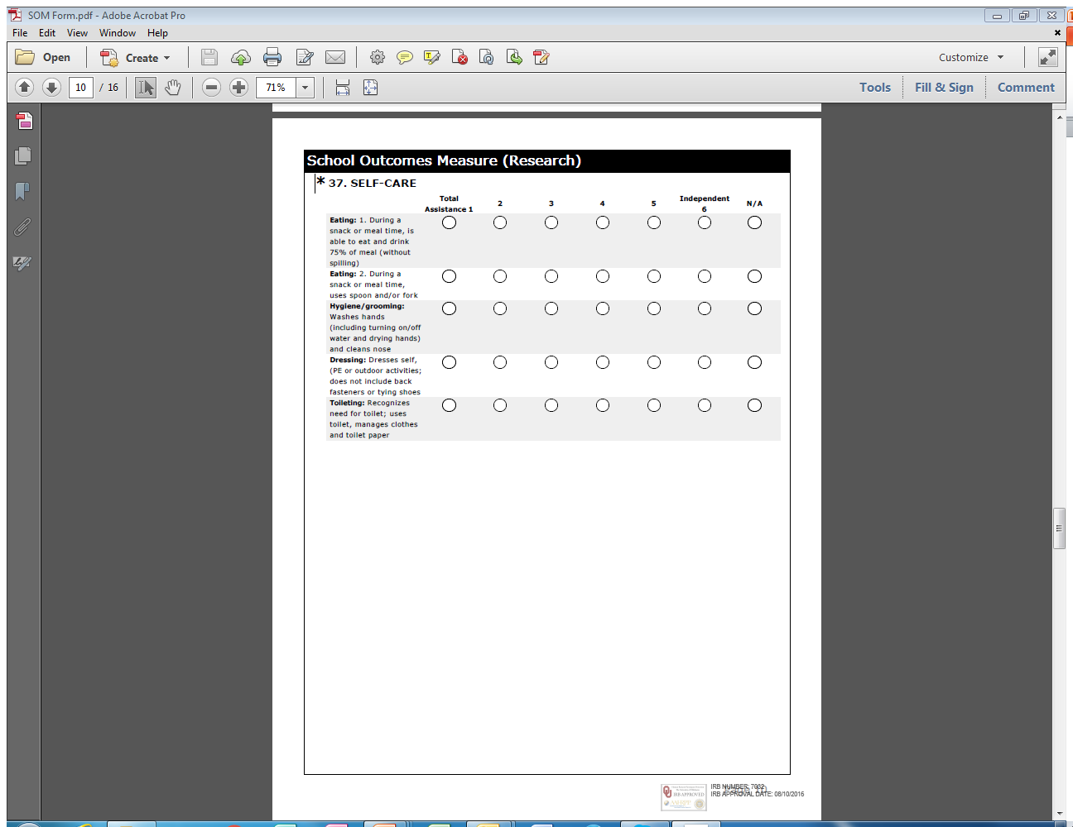
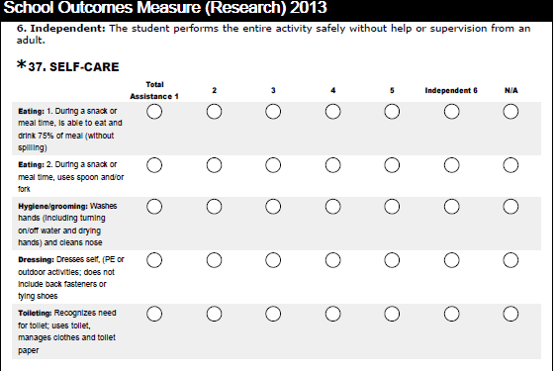
Notes:
Here is an example of how the items and Likert scale appear on the SOM.

Slide 17
Student Abilities: SOM Response Scale WITH Quality/Speed/Consistency Rating for Expressing Learning and Behavior
Indicate the level of assistance the student requires to perform the entire activity. The student may use adapted equipment or environment modification at any level of the scale.
Total Assistance: Student cannot perform the activity and does not provide any meaningful assistance OR the student cannot demonstrate quality, speed, or consistency.
Maximum Assistance: Adult assumes most of the responsibility for the activity and/or has hands on the student or materials for more than 1/2 of the activity OR the student’s quality, speed, or consistency are poor.
Moderate Assistance: An adult helps the student with the activity, with hands on the student or materials for less than or equal to 1/2 of the duration of the activity, but more than momentarily OR the student’s quality, speed, or consistency are fair.
Minimal Assistance: The student does the activity with only momentary hands on support by an adult OR the student’s quality, speed, or consistency are adequate but student needs improvement.
Supervision: An adult monitors the student's activities with verbal and/or gestural cues only - NO hands on the student OR the student’s quality, speed, or consistency are good.
Independent: The student performs the entire activity safely without help or supervision from an adult OR the student has no problems with quality, speed, or consistency.
N/A – not applicable
University of Oklahoma Health Sciences Center College of Allied Health, Department of Rehabilitation Sciences
Notes:
NOTE: When rating the functional areas of Expressing Learning and Behavior, the Likert scale includes an opportunity to assess either the students’ assistance or the student’s quality, speed, or consistency. Note the addition of the quality qualifier in each of the 6 assistance rating levels
In, Total assistance see “OR the student cannot demonstrate quality, speed, or consistency.” In Maximum see….
The opportunity for the therapist to score not applicable remains.

Slide 18
SELF-CARE
Eating: 1. During a snack or meal time, is able to eat and drink 75% of meal (without spilling)
Eating: 2. During a snack or meal time, uses spoon and/or fork
Hygiene/grooming: Washes hands (including turning on/off water and drying hands) and cleans nose
Dressing: Dresses self (PE or outdoor activities; does not include back fasteners or tying shoes)
Toileting: Recognizes need for toilet; uses toilet; and manages clothes and toilet paper
University of Oklahoma Health Sciences Center College of Allied Health, Department of Rehabilitation Sciences
Notes:
The following ten slides include all of the items on the SOM in each functional ability area. As reminder, each item consists of a complete activity and therapists are rating the students’ assistance on the entire activity/item. Also, as a reminder, the items are scored within the context of the school setting, and/or maybe included on the students IEP for related services.
[Audio, Sandra reads each item]

Slide 19
MOBILITY
Transfers: Gets in and out of wheelchair (if used), classroom chair, appropriately sized toilet seat, and bus seat
Simple mobility: Moves 50-100 feet on level surfaces both inside and outside (includes any means of mobility, does not include opening doors or carrying objects)
Classroom mobility: Travels within the classroom
School mobility: Travels around the school and school grounds
University of Oklahoma Health Sciences Center College of Allied Health, Department of Rehabilitation Sciences
Notes:
[Audio, Sandra reads each item]

Slide 20
MOBILITY (cont.)
Community mobility: Moves on all types of surfaces (e.g., cracked cement, grass), including ramps and low curbs and is able to carry objects while moving
Doors: 1. Opens and closes
Doors: 2. Moves through doorways
Bus transfers: Gets on and off the school bus (via stairs if ambulatory; via lift if uses wheelchair)
Stairs: Walks up and down a flight of stairs (12-15 steps)
University of Oklahoma Health Sciences Center College of Allied Health, Department of Rehabilitation Sciences
Notes:
[Audio, Sandra reads each item]

Slide 21
ASSUMING A STUDENT’S ROLE (for preschool/elementary students only)
Line: 1. Gets in line with classmates
Line: 2. Moves in line with classmates without bumping into them
Plays on playground
Does classroom/job-related activities (e.g., line leader, taking messages to the office)
Moves responsibly and purposefully through classroom learning centers
University of Oklahoma Health Sciences Center College of Allied Health, Department of Rehabilitation Sciences
Notes:
[Audio, Sandra reads each item]

Slide 22
ASSUMING A STUDENT’S ROLE (for secondary students only)
Opens and closes locker
Goes off campus for lunch
Does off campus job-related activities
Accesses vending machines
Engages in leisure activities
University of Oklahoma Health Sciences Center College of Allied Health, Department of Rehabilitation Sciences
Notes:
[Audio, Sandra reads each item]

Slide 23
ASSUMING A STUDENT’S ROLE (for all students)
Gets teacher’s attention
Obtains classroom materials (e.g., paper, books, art supplies)
Carries: 1. Lunch tray to/from lunch table without spilling
Carries: 2. Sack lunch to/from lunch table without spilling
Carries: 3. Drink to/from lunch table without spilling
University of Oklahoma Health Sciences Center College of Allied Health, Department of Rehabilitation Sciences
Notes:
[Audio, Sandra reads each item]

Slide 24
ASSUMING A STUDENT’S ROLE (for all students – cont.)
Manipulates classroom materials: 1. Cutting and pasting
Manipulates classroom materials: 2. Books
Manipulates classroom materials: 3. Science activities
Engages in after school activities (e.g., clubs, teams)
Engages in community activities: 1. Movies
Engages in community activities: 2. Sports
Engages in community activities: 3. Going to mall
University of Oklahoma Health Sciences Center College of Allied Health, Department of Rehabilitation Sciences
Notes:
[Audio, Sandra reads each item]

Slide 25
EXPRESSING LEARNING (for students unable to use speech)
Augmentative Communication: 1. Physically accesses a picture board using any body part
Augmentative Communication: 2. Physically accesses an electronic device using any body part
University of Oklahoma Health Sciences Center College of Allied Health, Department of Rehabilitation Sciences
Notes:
[Audio, Sandra reads each item]

Slide 26
EXPRESSING LEARNING (for ALL students )
Produces words and numbers (or prewriting activities) using handwriting
Produces words and numbers (or prewriting activities) using a computer
Copies classwork: 1. From the chalkboard
Copies classwork: 2. From a book or work page
University of Oklahoma Health Sciences Center College of Allied Health, Department of Rehabilitation Sciences
Notes:
[Audio, Sandra reads each item]

Slide 27
BEHAVIOR
Stays on task in the classroom
Maintains acceptable behavioral control in school
Interacts cooperatively and appropriately with other students
Follow directions
University of Oklahoma Health Sciences Center College of Allied Health, Department of Rehabilitation Sciences
Notes:
[Audio, Sandra reads each item]

Slide 28
School Outcomes Measure (SOM)™ Research Web Page
From The University of Oklahoma Health Sciences Center web page http://ouhsc.edu/
At search bar, type in “Tolbert Center” select fist link (Lee Mitchener Tolbert Center for Developmental Disabilities & Autism) http://alliedhealth.ouhsc.edu/Departments/RehabilitationSciences/CenterofExcellence/LeeMitchenerTolbertCenter.aspx
Then, under the Quick links on the right, click on School Outcomes Measure (SOM) Research
OR
from OUHSC.edu , at search bar, type in “School Outcomes Measure” select first link and will take you directly to School Outcomes Measure (SOM) Research http://alliedhealth.ouhsc.edu/Departments/RehabilitationSciences/CenterofExcellence/LeeMitchenerTolbertCenter.aspx
University of Oklahoma Health Sciences Center College of Allied Health, Department of Rehabilitation Sciences
Notes:
We have developed a SOM Research Web page, that you can access from the University of Oklahoma Health Sciences Center, Lee Mitchener Tolbert Center for Developmental Disabilities & Autism web sites. See the navigation and direct links on this slide.
Included on the SOM Research Web page are an introduction to and contact for our National IES SOM Validation Study. In addition we have included password protected tools and items for the reliability training, that your SSC will have access too. Further the web page includes additional research tools for you for example the Gross Motor Function Classification System and the Manual Ability Classification System hyperlinks.

Slide 29
Reliability Testing
Student Videos
Discussion
Testing
University of Oklahoma Health Sciences Center College of Allied Health, Department of Rehabilitation Sciences
Notes:
Now it is time to begin the SOM reliability training. Your SSC will assist you with the SOM Reliability Video, the SOM Items for Reliability form, and the SOM Reliability Excel Sheet for scoring.
Thank you again for your participation in this study.

Slide 30
References (not fully included in ppt)
American Occupational Therapy Association (2000). Occupational therapy practice trends. Retrieved March 10, 2017, from http://www.aota.org/-/media/corporate/files/advocacy/hill-day-12/hill-day-ot-fact-sheet.pdf
American Occupational Therapy Association (2000). American occupational therapy association 2000 salary survey. Retrieved October 1, 2007, from the American Occupational Therapy Association Web site: http://www.otjoblink.org/links/link04.asp
American Physical Therapy Association. (2002). Pediatric physical therapy description of practice. Alexandria, VA: Author.
Bundy, A. C2002. (Ed.) (1991). Making a difference: OTs and PTs in public schools: A conceptual model of practice for school system therapists. Chicago: University of Illinois at Chicago.
Dobrzykowski, E. A. (1998). Essential readings in rehabilitation outcomes measurement: Application, methodology, and technology. Gaithersburg, MD: Aspen Publishers, Inc. Goossen, W. T. F., Epping, P. J. M. M., Feuth, Dassen, T. W. N., Hasman, A., & Heuvel, W. (1998). A comparison of nursing minimal data sets. Journal of the American Medical Informatics Association, 5(2), 152-163.
McEwen, I. R., Arnold, S. H., Hansen, L. H., & Johnson, D. (2003). Interrater reliability and content validity of a minimal data set to measure outcomes of students receiving school-based occupational therapy and physical therapy. Physical and Occupational Therapy in Pediatrics, 23(2), 77-95.
U.S. Department of Education. Code of Federal Regulations, 34 Federal Register (34 CFR), parts 300 (2006).
University of Oklahoma Health Sciences Center College of Allied Health, Department of Rehabilitation Sciences
Notes:
[No audio]

